Slide 1
USA Covid 19 cases Vs Mobility
Fahar Zaheer

Slide 2
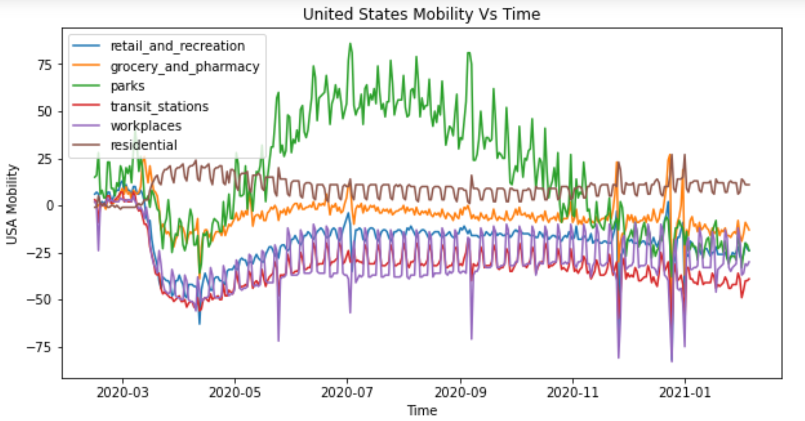
United States Mobility over time

Slide 3
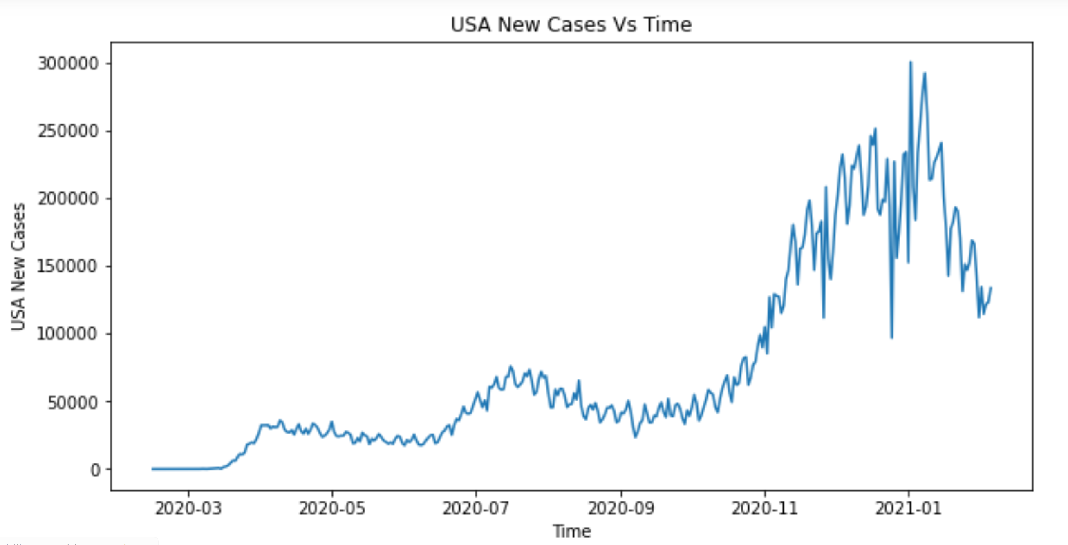
Daily new covid 19 cases(usa)

Slide 4
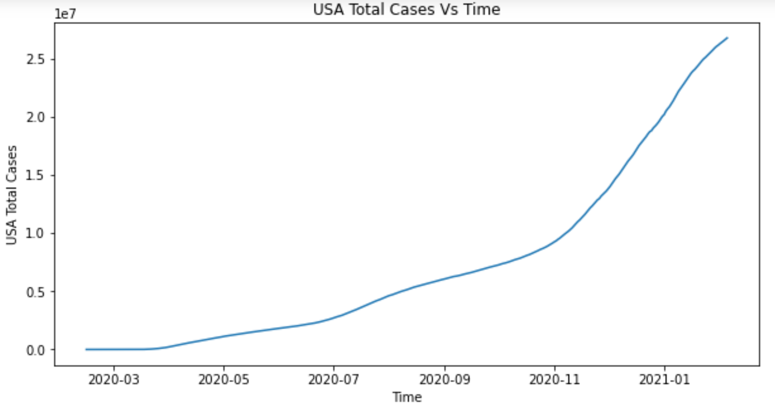
Total covid 19 cases over time(usa)

Slide 5
Correlation of daily cases to each mobility type
The correlation between new_cases and retail_and_recreation is -0.1
The correlation between new_cases and grocery_and_pharmacy is -0.23
The correlation between new_cases and parks is -0.52
The correlation between new_cases and transit_stations is -0.31
The correlation between new_cases and workplaces is -0.09
The correlation between new_cases and residential is 0.12

